Slide 1
Privacy-Preserving Federated Hybrid Ensemble (EfficientNetB3-InceptionV3) for Multi-Class Skin Lesion Classification
B.Sc. Final-Defense
Name: Amit Kumar Ghosh
ID : 221-15-4650
Department : CSE
Daffodil International University

Slide 2
Outline
Introduction
Problem Statement
Objective
Background Study
Gap Analysis
Methodology
Results & Analysis
Novelty of the Work
Sample Dataset & Expected Output
Web Interface
Conclusion
References
B.Sc. Final-Defense

Slide 3
Introduction
Rising Global skin Cancer Rates
Subjective Manual Diagnosis
Automated AI Classification
Federated learning privacy
Hybrid Ensemble Architecture
Clinical Impact and Performance
B.Sc. Final-Defense

Slide 4
Problem Statement
High Mortality Risks: Late detection kills
Subjective Human Error: Doctors disagree often
Expensive Invasive Biopsies: Painful and costly
Severe class imbalance: Real world data imbalance
Data Privacy Concerns: Patient data risks
Clinical deployment needed: Health Aid System
B.Sc. Final-Defense

Slide 5
Objectives
Preserve patient privacy via federated learning while maintaining strong predictive performance.
Deliver a deployable clinical decision-support health aid system.
Design a dual-backbone ensemble classifier (EfficientNet-B3 + InceptionV3).​
B.Sc. Final-Defense

Slide 6
Background Study
References | Objectives | Methods | Results | Limitations
Yaqoob et al. [1] | Privacy-aware skin cancer detection using federated learning with asynchronous training | Asynchronous Federated Learning with CNNs on HAM10000; local model training with delayed aggregation to handle client availability | Accuracy: 87.3%; improved privacy preservation; reduced communication rounds by 40% compared to synchronous FL | Limited to binary classification (melanoma vs non-melanoma); simple CNN architecture; no attention mechanism for interpretability
Hendrix et al. [2] | Evidential federated learning with prompt tuning for uncertainty-aware skin lesion classification | FedEvPrompt integrating Vision Transformers with b-prompts and t-prompts; knowledge distillation on attention maps; evidential learning framework on ISIC2019 | Accuracy: 91.4%; improved uncertainty quantification; enhanced privacy by sharing attention maps only (not parameters); handles data heterogeneity | Computational overhead of Vision Transformers; requires pretrained ViT models; limited evaluation on HAM10000 multi-class problem
Tian et al. [3] | Communication-efficient federated learning using dataset distillation for skin lesion classification | Generalizable Dataset Distillation (GDD) synthesizing small representative datasets; Gaussian distribution modeling; transmits synthetic images instead of parameters | 50× reduction in communication cost; accuracy: 88.6%; faster convergence (5 rounds vs 20 for FedAvg) | Synthetic images may lose fine-grained dermatoscopic details; limited to 3-class problem; privacy concerns with sharing synthetic data
Shetty et al. [4] | Multi-class skin lesion classification on HAM10000 using CNN and machine learning | Custom CNN architectures with data augmentation; comparison with SVM, Random Forest, KNN on HAM10000 seven classes | CNN accuracy: 89.3%; SVM: 72.4%; Random Forest: 68.1%; effective feature extraction for pigmented lesions | Centralized training (no privacy preservation); no federated approach; limited generalization to external datasets; class imbalance not addressed
Deng et al. [5] | Federated active learning for efficient annotation in skin lesion classification | Active learning strategy selecting informative samples for annotation; federated setup with uncertainty sampling | Achieved state-of-the-art performance using only 50% of annotated samples; reduced annotation cost by 50% | Requires initial labeled data; uncertainty estimation overhead; limited evaluation on rare lesion classes
B.Sc. Final-Defense

Slide 7
Gap Analysis
Feature | Centralized CNN on HAM10000 papers[1][4] | FL melanoma detection papers [2] | Ensemble papers HAM10000 (centralized) | Proposed federated hybrid
7‑class HAM10000 | Yes | No (binary) | Yes | Yes
Federated learning | No | Yes | No | Yes
Non‑IID client distribution modeled | No | Partial | No | Yes
Explicit imbalance handling (oversamp) | Limited | No | Limited | Yes (RandomOverSampler)
Hybrid dual‑backbone with attention | No | No | No | Yes
Explainability (Grad‑CAM etc.) | Partial | No | Partial | Yes
Systematic ablation studies reported | Limited | No | Limited | Yes (imbalance, aug.)
Deployment and system implementation | Prototype / research code | Prototype only | Prototype only | Fully functional offline desktop system (no internet required)
B.Sc. Final-Defense

Slide 8
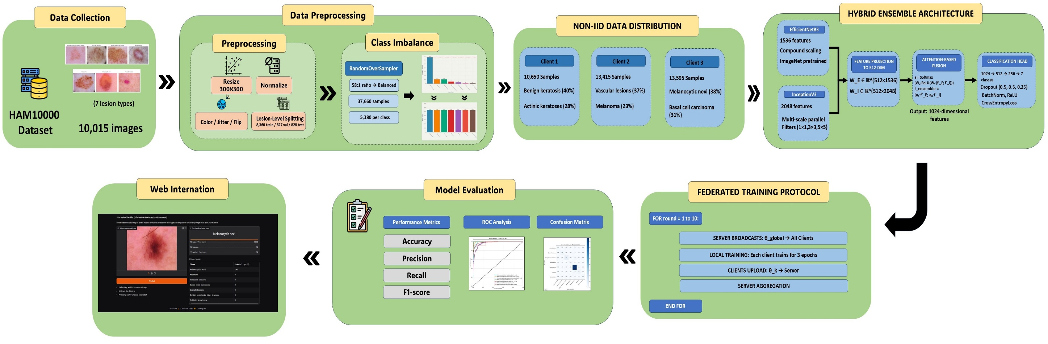
Methodology
Fig 1: Proposed Federated Learning Methodology Workflow
B.Sc. Final-Defense

Slide 9
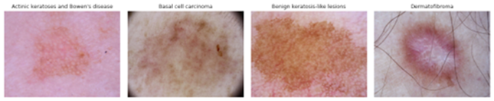
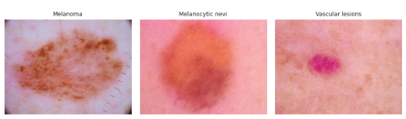
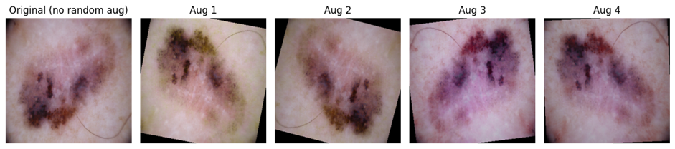
Methodology
Data Acquisition: The HAM10000 dataset provides 10,015 dermatoscopic RGB images [6].
Data Preprocessing and Augmentation:
All dermoscopic images are resized to 300×300 pixels in RGB space and normalized using dataset-specific statistics. During training, random augmentations such as flips, rotations, zoom, and color jitter are applied.
Fig. 2. Representative Dermoscopic Images of the Seven HAM10000 Skin Lesion Categories
Fig 3: Examples of Random Data Augmentations Applied to a Dermoscopic Image
B.Sc. Final-Defense

Slide 10
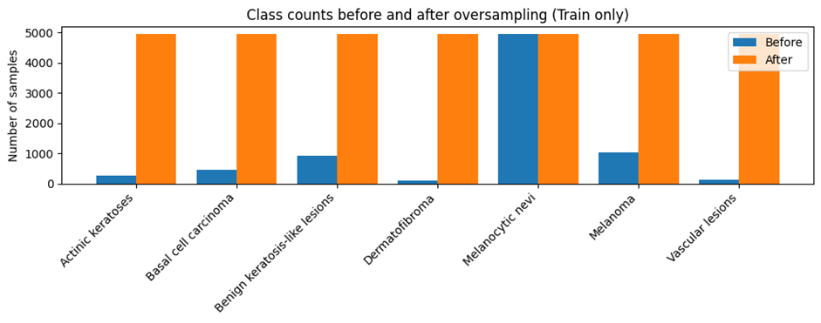
Methodology
Class Imbalance Handling: The HAM:10000 dataset is highly Skewed, if not addressed the model could get biased towards heavy clases.
Data Splitting: Dataset divided into 80% training, 10% validation, and 10% testing sets.
Table I: Training Set Class Counts Before and After Oversampling
Class | Count before oversampling | Count after oversampling
Melanocytic nevi | 4,939 | 4,939
Melanoma | 1,021 | 4,939
Benign keratosis-like lesions | 923 | 4,939
Basal cell carcinoma | 444 | 4,939
Actinic keratoses | 267 | 4,939
Vascular lesions | 116 | 4,939
Dermatofibroma | 99 | 4,939
Fig. 4. Training Class Counts Before and After Oversampling
B.Sc. Final-Defense

Slide 11
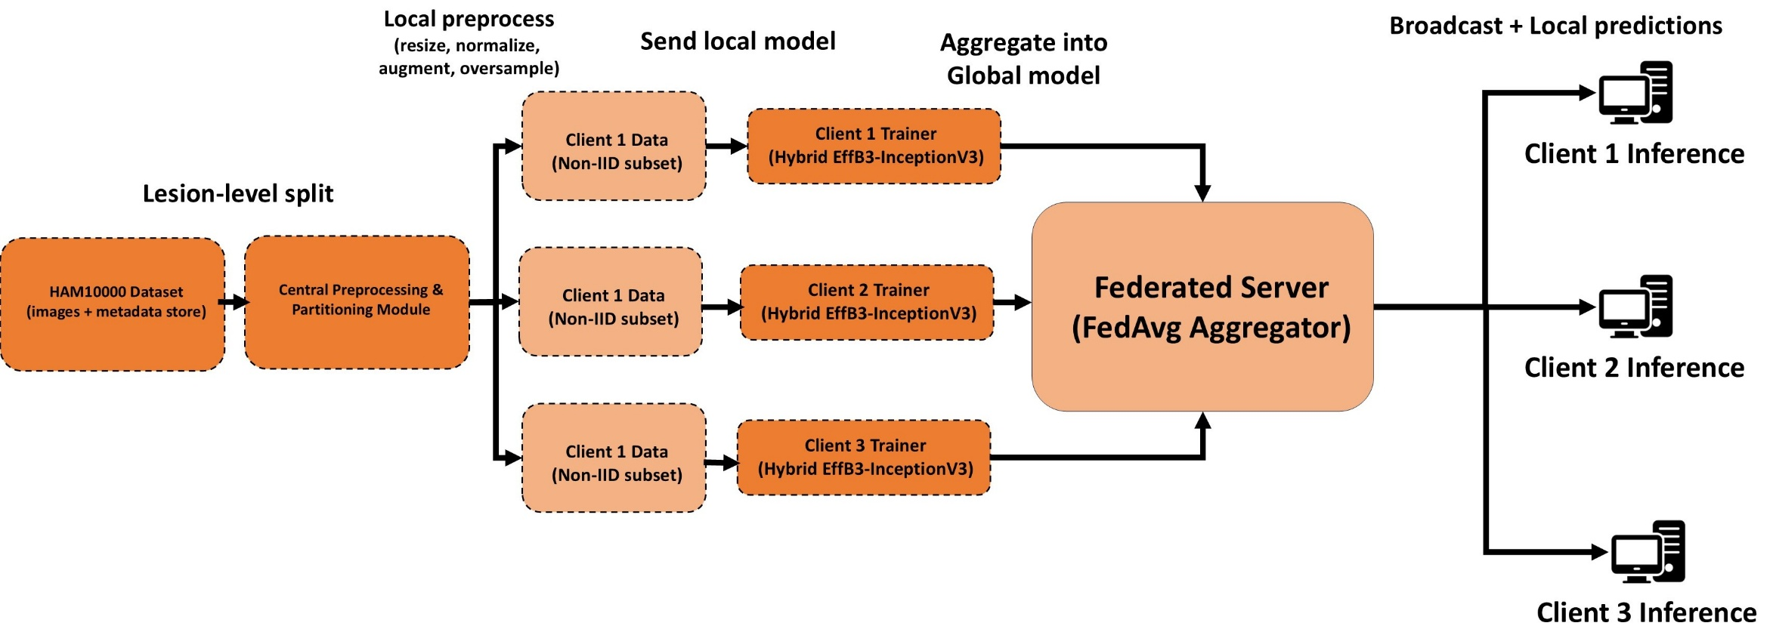
Methodology
3 Federated Client: The Train set was distributed into 3 client.
Developing Proposed Model: A Hybrid combination of EfficientNetB3 and InceptionV3 frameworks with attention-driven feature fusion
Fig 5: Data Flow of the Federated Clients
B.Sc. Final-Defense

Slide 12
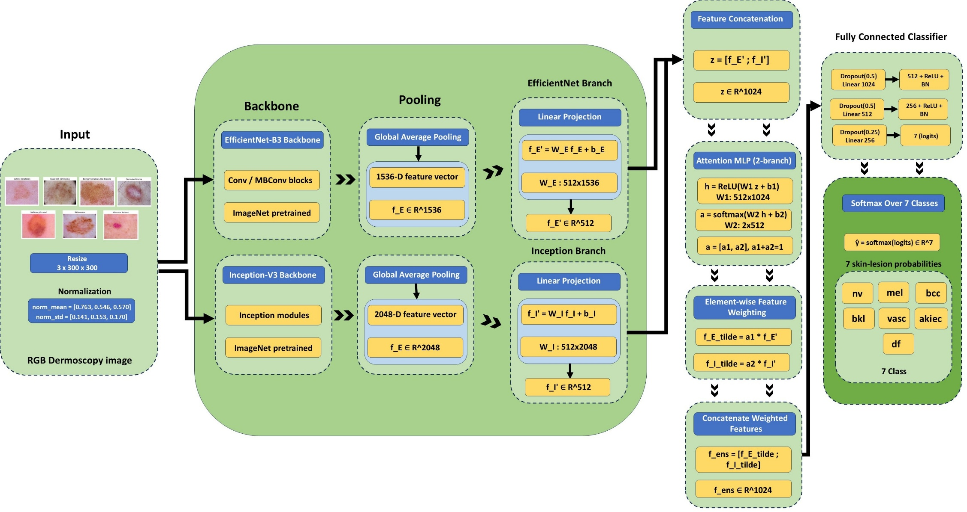
Proposed Model Architecture
Fig 6: Architecture of Proposed Hybrid EfficientNetB3–InceptionV3 Ensemble
B.Sc. Final-Defense

Slide 13
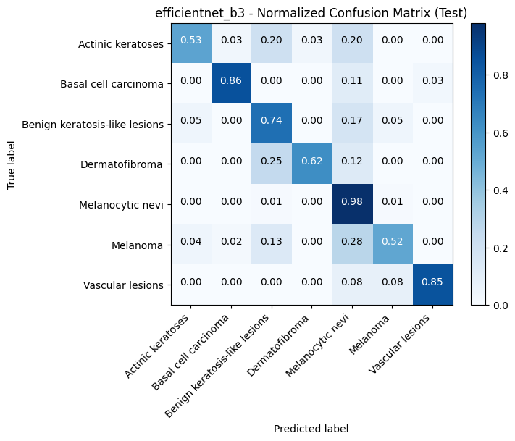
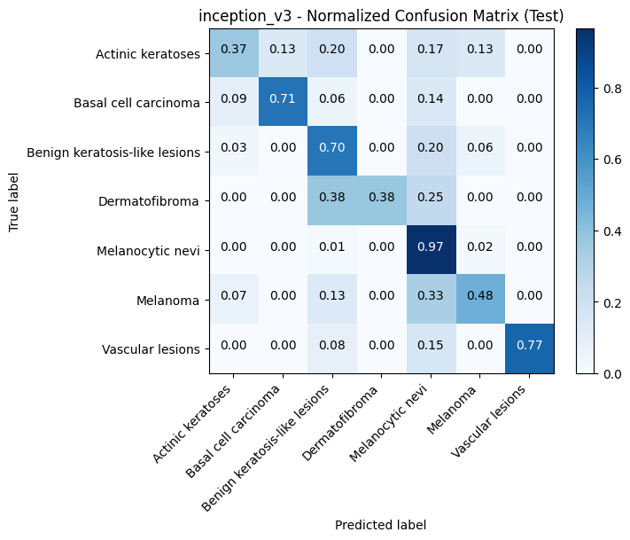
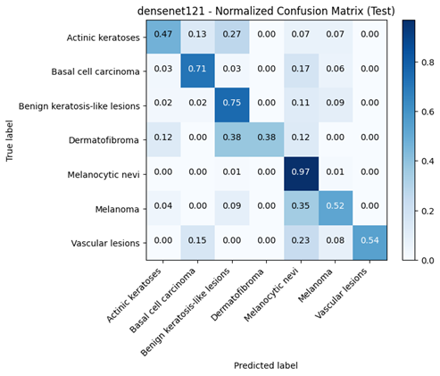
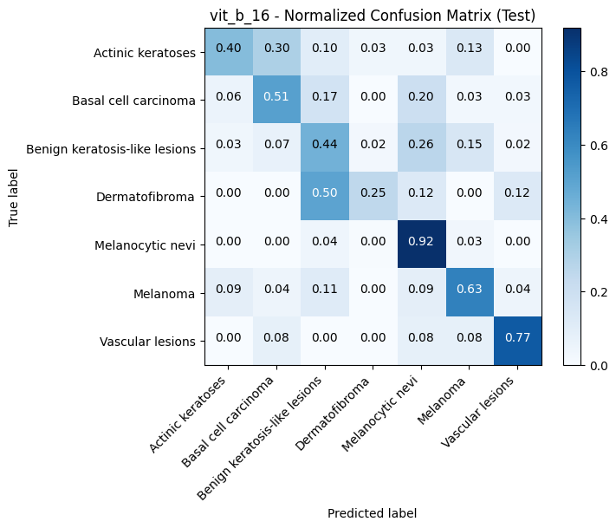
Result and Analysis
Fig. 7. Confusion Matrix of EfficientNetB3, InceptionV3, Densenet121, Vit_b_16
B.Sc. Final-Defense

Slide 14
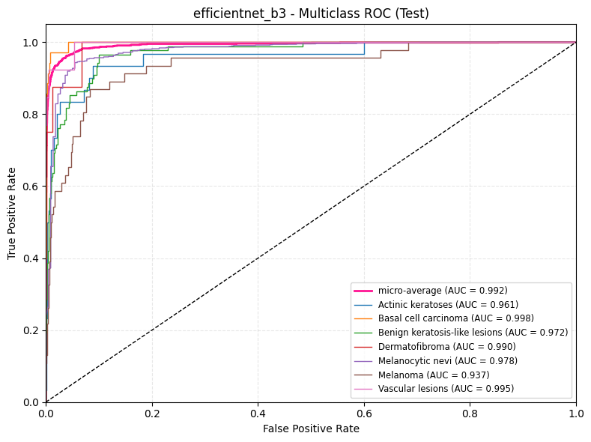
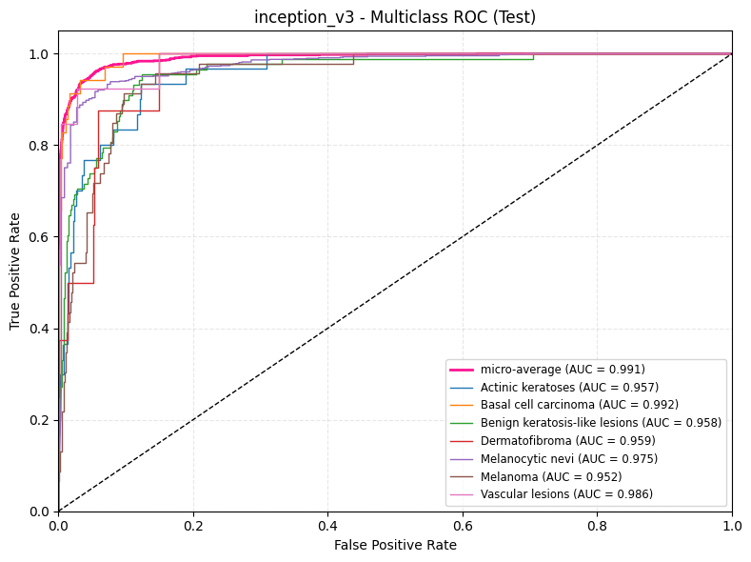
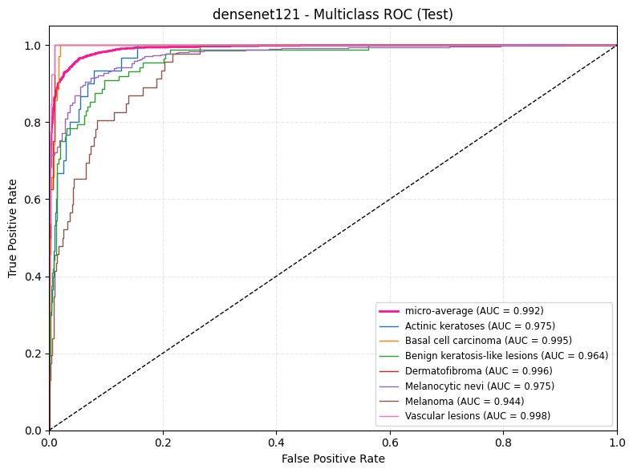
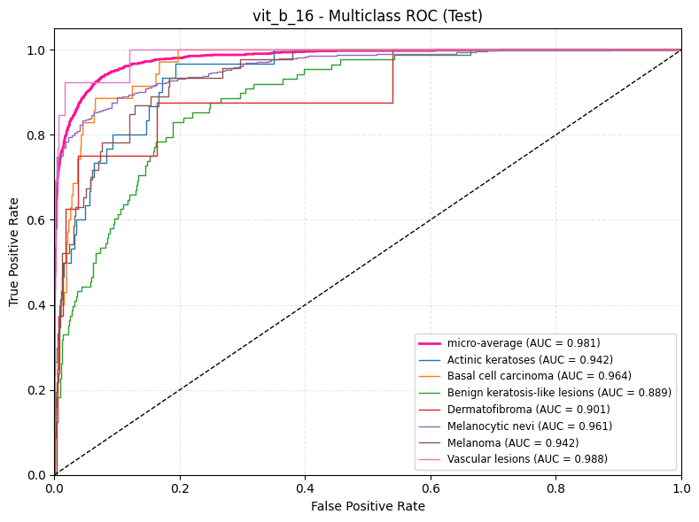
Result and Analysis
Fig. 8. Multi Class ROC-Curve of EfficientNetB3, InceptionV3, Densenet121, Vit_b_16
B.Sc. Final-Defense

Slide 15
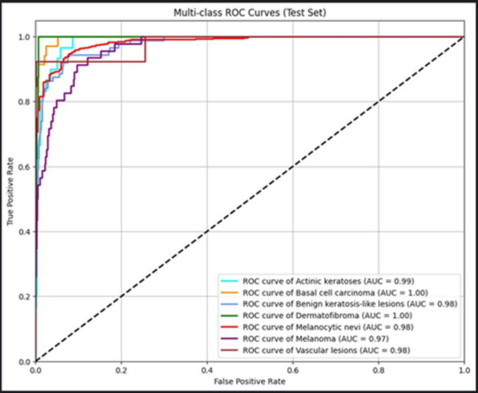
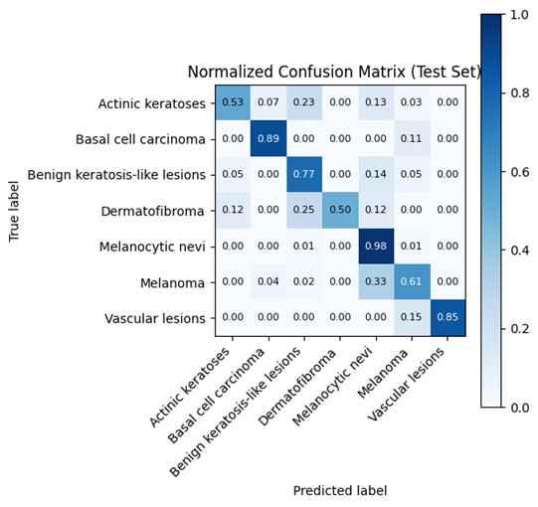
Result and Analysis
Fig. 9. Multi Class ROC-Curve of Proposed Model
Fig. 10. Confusion Matrix of Proposed Model
B.Sc. Final-Defense

Slide 16
Result and Analysis
Table II: Proposed model and Baseline model comparison
Table III: Classification Report of the Proposed Model
Model | Accuracy
GCN | 62.34%
GAT | 61.23%
Hybrid GCN-GAT | 54.76%
VGG-16 | 82.79%
VGG-19 | 86.23%
ResNet-50 | 89.67%
DenseNet-121 | 90%
EfficientNet-B3 | 91.02%
Inception-V3 | 89.35%
ViT-b-16 | 78.45%
Proposed model | 93.62%
Class | Precision | Recall | F1-score | Support
Actinic keratoses ​ | 0.72 ​ | 0.60 ​ | 0.65 ​ | 30 ​
Basal cell carcinoma ​ | 0.86 ​ | 0.89 ​ | 0.87 ​ | 35 ​
Benign keratosis-like lesions ​ | 0.83 ​ | 0.77 ​ | 0.80 ​ | 88 ​
Dermatofibroma ​ | 1.00 ​ | 0.62 ​ | 0.77 ​ | 8 ​
Melanocytic nevi ​ | 0.96 ​ | 0.98 ​ | 0.97 ​ | 883 ​
Melanoma ​ | 0.65 ​ | 0.61 ​ | 0.63 ​ | 46 ​
Vascular lesions ​ | 1.00 ​ | 0.85 ​ | 0.92 ​ | 13 ​
Accuracy ​ |  |  | 0.9362 | 1103 ​
Macro avg ​ | 0.86 ​ | 0.76 ​ | 0.80 ​ | 1103 ​
Weighted avg ​ | 0.93 ​ | 0.93 ​ | 0.93 ​ | 1103
B.Sc. Final-Defense

Slide 17
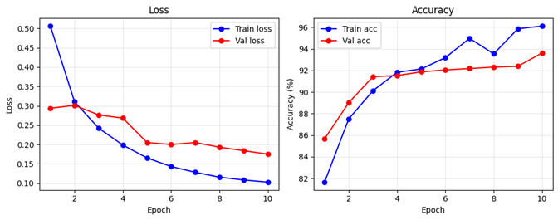
Result and Analysis
Table IV: Training parameter for the proposed model
Hyperparameter | Value
Input Shape | 300 x 300
Batch Size | 32 (Effective)
Epochs | 10
Optimizer | Adam
Learning Rate | 1e-4 (0.0001)
Loss Function | Cross-Entropy
Fig 11. Training and validation loss and accuracy curves
B.Sc. Final-Defense

Slide 18
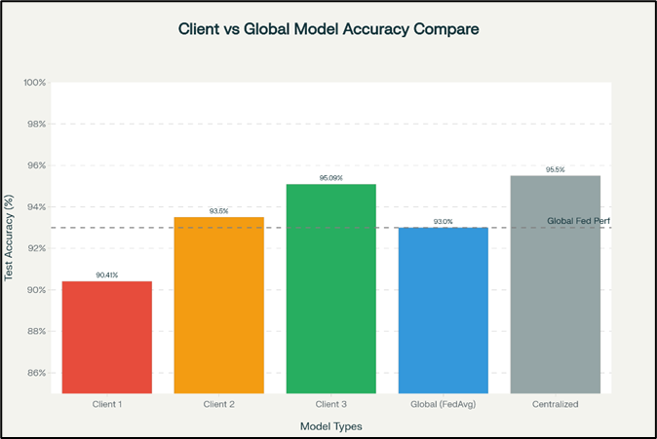
Analysis of Federate Clients
Table V: Federated Client-wise and Global Hybrid Model Accuracy
Component | Train Acc (%) | Test Acc (%)
Client 1 | 92.78 | 90.41
Client 2 | 96.18 | 93.50
Client 3 | 97.97 | 95.09
Global Model (Hybrid EfficientNetB3-InceptionV3 Ensemble Mode) | 94.97 | 93.00
Fig. 12. Accuracy Comparison Bar Chart of Federate clients and Global Model
B.Sc. Final-Defense

Slide 19
Analysis of Ablation Study
Table VI: Ablation study Of Proposed and baseline models
This table compares different baseline models and shows that the proposed hybrid ensemble achieves the highest test accuracy (93.62%), and still performs best even when oversampling (SMOTE) or data augmentation are removed.
Model | Without SMOTE | Without Augmentation | Accuracy
GCN | 52% | 61% | 62.34%
GAT | 54% | 62% | 61.23%
Hybrid GCN-GAT | 50% | 54% | 54.76%
VGG-16 | 68% | 85% | 82.79%
VGG-19 | 67% | 84% | 86.23%
ResNet-50 | 66% | 88% | 89.67%
DenseNet-121 | 72% | 90% | 90%
EfficientNet-B3 | 67% | 90% | 91.02%
Inception-V3 | 74% | 89% | 89.35%
ViT-b-16 | 59% | 77% | 78.45%
Proposed model | 80% | 92.81% | 93.62%
B.Sc. Final-Defense

Slide 20
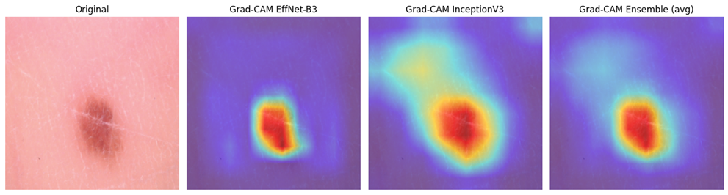
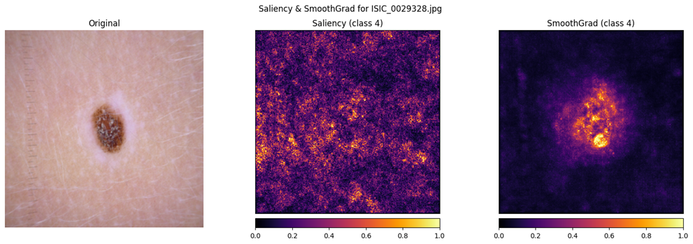
Result and Analysis
Grad‑CAM heatmaps from EfficientNet‑B3, InceptionV3, and their ensemble show that the hybrid model concentrates on the lesion itself, matching clinically relevant regions.
Saliency and SmoothGrad highlight the pixels most responsible for the model’s decision on a class‑4 lesion, with SmoothGrad giving a cleaner focus on the lesion area.
Fig. 13: Grad‑CAM skin‑lesion visualizations
Fig. 14:Saliency and SmoothGrad maps for class-4 skin lesion
B.Sc. Final-Defense

Slide 21
Novelty of the Work
Dual-Backbone Ensemble in Federated Setting: First hybrid EfficientNetB3-InceptionV3 ensemble under federated learning for dermatology
Attention-Based Feature Fusion: Sample-specific weighted fusion improves robustness vs. simple concatenation
Non-IID Class Imbalance Handling: RandomOverSampler + Dirichlet partitioning + FedAvg addresses both challenges simultaneously
Comprehensive Multi-Class Benchmark: 11 baseline comparisons (CNNs, Transformers, Graph-Based) on 7-class HAM10000
Practical Deployment: Demonstrates privacy-preserving collaboration with minimal accuracy gap (0.62%)
B.Sc. Final-Defense

Slide 22

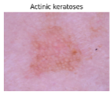
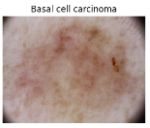
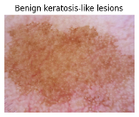
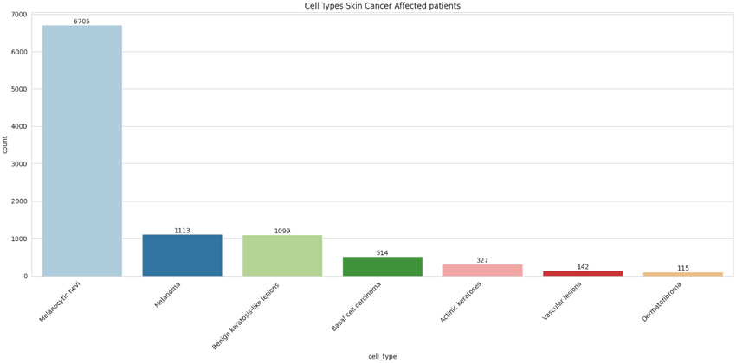
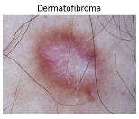
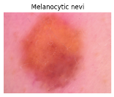
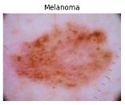
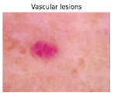
Sample dataset
Class | Image
Actinic keratoses
Basal cell carcinoma
Benign keratosis-like lesions
Dermatofibroma
Melanocytic nevi
Melanoma
Vascular lesions
B.Sc. Final-Defense

Slide 23
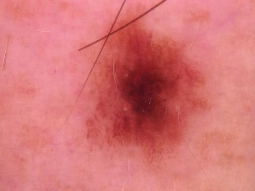
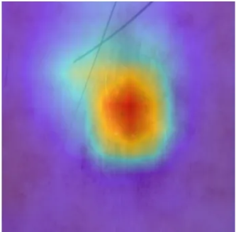
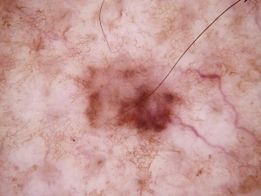
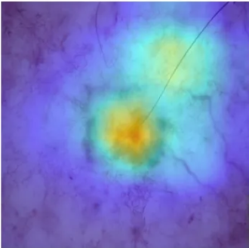
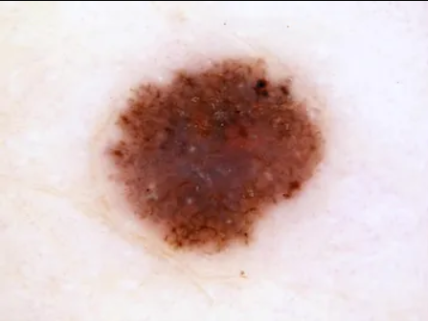
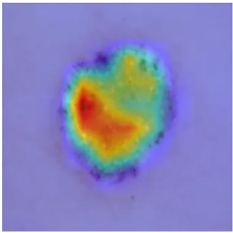
Sample dataset and Expected output
True Class | Ground Truth Image | Model Prediction | Confidence | Grad-CAM
Melanocytic nevi |  | Melanocytic nevi | 100%
Melanoma |  | Melanoma (98%) Nevi (2%) | 98% confident
Melanoma |  | Keratosis | 65%
Misclassified
B.Sc. Final-Defense

Slide 24
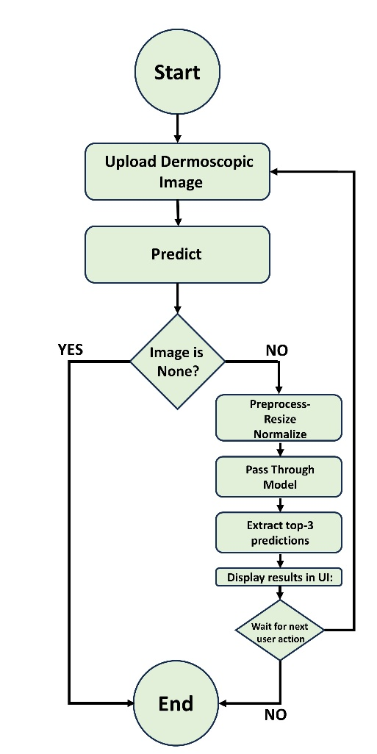
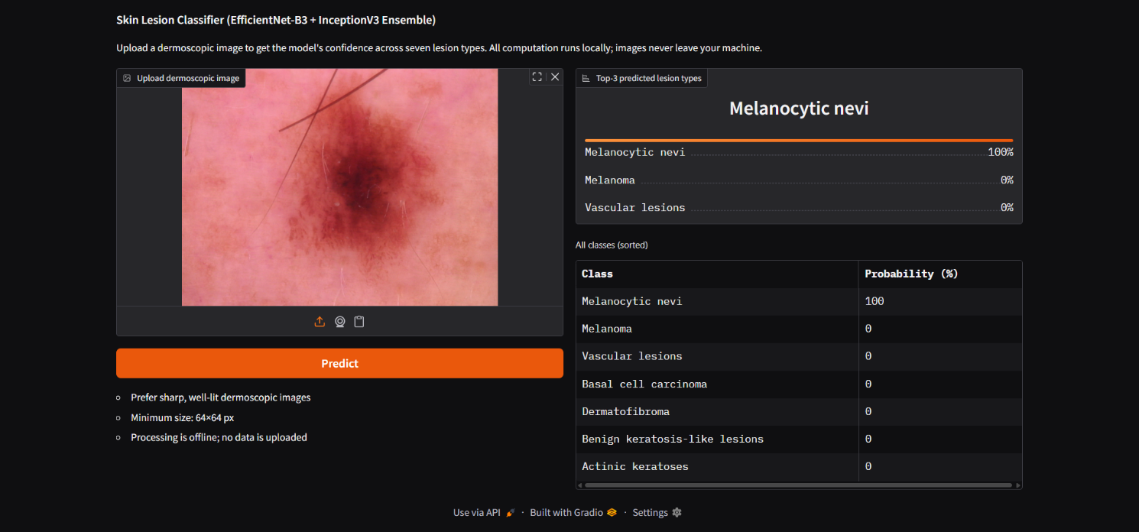
Web Interface of Image Enhancement
Fig. 14: User Dashboard of Skin Lesion Classifier
Fig. 16: Activity diagram of the skin‑lesion classifier inference workflow
B.Sc. Final-Defense

Slide 25
Comparative Analysis
Reference / Author | Methodology | Privacy Preserving (FL) | Multi-Class (7 Classes) | Addressed Class Imbalance? | Explainability (Grad-CAM) | Key Limitation
Yaqoob et al. [1] | CNN with Asynchronous Federated Learning | ✅ Yes | ❌ No (Binary) | ❌ No | ❌ No | Limited to only 2 classes (Benign vs. Malignant); no imbalance handling.
Hendrix et al. [2] | Evidential Deep Learning (EDL) | ✅ Yes | ✅ Yes | ❌ No | ❌ No | Focuses on uncertainty estimation but ignores the severe class imbalance in HAM10000.
Tian et al. [3] | Dataset Distillation with FL | ✅ Yes | ✅ Yes | ❌ No | ❌ No | Computationally expensive; struggles with "Non-IID" data (diverse hospital data).
Shetty et al. [4] | CNN + Transfer Learning | ❌ No | ✅ Yes | ✅ Yes | ❌ No | No Privacy. Requires centralized data sharing, violating medical regulations (HIPAA).
Proposed Model | Hybrid Ensemble (EffNetB3 + InceptionV3) | ✅ Yes | ✅ Yes | ✅ Yes | ✅ Yes | None. Combines privacy, high accuracy (93.62%), imbalance handling, and doctor-friendly explainability.
B.Sc. Final-Defense

Slide 26
Conclusion
Our federated hybrid EfficientNetB3–InceptionV3 model achieves over 93% accuracy on seven skin‑lesion classes while keeping all images at their own hospitals, showing that privacy‑preserving collaboration is both effective and practical.​ By handling class imbalance and providing Grad‑CAM and saliency visualizations, the system offers reliable predictions and clear visual explanations that can support dermatologists as a Health Aid tool and can be extended in future work to larger deployments.
B.Sc. Final-Defense

Slide 27
References
[1] Muhammad Mateen Yaqoob, Musleh Alsulami, Muhammad Amir Khan, Deafallah Alsadie, A. Khader, and M. Alkhathami, “Federated Machine Learning for Skin Lesion Diagnosis: An Asynchronous and Weighted Approach,” Diagnostics, vol. 13, no. 11, pp. 1964–1964, Jun. 2023, doi: https://doi.org/10.3390/diagnostics13111964.
[2] R. Hendrix, S. F. Proietto, C. Spampinato, S. Palazzo, and U. Bagci, “Evidential Federated Learning for Skin Lesion Image Classification,” arXiv (Cornell University), Nov. 2024, doi: https://doi.org/10.48550/arxiv.2411.10071.
[3] Y. Tian, J. Wang, Y. Jin, and L. Wang, “Communication-Efficient Federated Skin Lesion Classification with Generalizable Dataset Distillation,” Lecture notes in computer science, pp. 14–24, Jan. 2023, doi: https://doi.org/10.1007/978-3-031-47401-9_2.
[4] B. Shetty, R. Fernandes, A. P. Rodrigues, R. Chengoden, S. Bhattacharya, and K. Lakshmanna, “Skin lesion classification of dermoscopic images using machine learning and convolutional neural network,” Scientific Reports, vol. 12, no. 1, p. 18134, Oct. 2022, doi: https://doi.org/10.1038/s41598-022-22644-9.
[5] Z. Deng, Y. Yang, and K. Suzuki, “Federated Active Learning Framework for Efficient Annotation Strategy in Skin-Lesion Classification,” Journal of Investigative Dermatology, Jun. 2024, doi: https://doi.org/10.1016/j.jid.2024.05.023.
[6] “Skin Cancer MNIST: HAM10000,” www.kaggle.com. https://www.kaggle.com/datasets/kmader/skin-cancer-mnist-ham10000
B.Sc. Final-Defense

Slide 28
THANK YOU
B.Sc. Final-Defense

